Slide 1
Planning for Growth and Transportation in Osceola County
Smart Growth Strategies & Project Delivery
Leadership Osceola
March 25, 2026
Notes:
Cori introduce self and what Community Development does
Jennifer introduce self and what Transportation & Transit does
Picture this: It’s 2035, and you’re driving through Osceola County. But this isn’t the Osceola you knew just a decade ago. The roads flow seamlessly, connecting vibrant communities with bustling hubs of activity. Cyclists glide along dedicated paths, families stroll down walkable streets, and businesses thrive in interconnected districts. This is the future we’re building—a future where smart growth and thoughtful planning have transformed our county into a model of sustainable mobility and livable spaces.
But let’s step back for a moment. How do we get there? Right now, Osceola County is one of the fastest-growing regions in Florida. With our population expected to reach 827,000 by 2045, the challenges we face today—traffic congestion, infrastructure demands, rising construction costs—can feel overwhelming. But here’s the thing: Growth isn’t the enemy. It’s an opportunity. It’s a force we can harness to shape a better future. And that’s exactly what we’re doing.

Slide 2
Agenda Overview
Osceola County
Comprehensive Planning
Transportation Planning
Driving Into The Future With Confidence
Notes:
We’ll explore how our comprehensive planning, transportation planning, and strategic partnerships are transforming the way we integrate land use and transportation. Together, these tools are paving the way—literally—for a future that’s connected, efficient, and sustainable.
As members of business organizations and leaders in our community, you understand the power of collaboration and innovation. In this room, we have the expertise, the vision, and the responsibility to shape the journeys of tomorrow. So, let’s dive in. Let’s explore how Osceola County, all of us together, are driving into the future with confidence.
To begin, let’s look at how smart growth and comprehensive planning set the foundation for everything we do. Because as they say, if you fail to plan, you plan to fail. And failure is not an option for the future we’re building.

Slide 3
Changes to Growth Management law
2011
SunRail service
to Osceola
2018
Great Recession
2007-2009
Covid
2020 - 2022
Mobility Fee Study and Implementation
JPA ILA with the City of St. Cloud for Annexations
Narcoosee Overlay in LDC
Adopted Conceptual Master Plans (CMPs) for Mixed Use Districts (MXDs)
Comprehensive Plan update
Parks Master Plan
Centers and Mixed Use
Comprehensive Plan update
ACL CMP Community Outreach and Study
Urban Land Institute Panel
Lake Toho DRIs 2005-2007
Restructured LDC
Adopted MXD code
Comprehensive Plan update
FLUE Industrial and ACL CMP
2005 | 2007 | 2008 | 2010 | 2011 | 2012 | 2013 | 2014 |  | 2017 | 2018 | 2019 | 2020 | 2021 | 2022 | 2023
2005
EAR Based Amendments and ORC Report
Comprehensive Plan update via Settlement Agreement…
Established Urban Growth Boundary and Mixed Use Districts
Transportation Element Update
ELT, SLT MXD Rezoning
Sustainability Report
Fiscally sustainable growth
Affordable housing
Jobs housing balance
Land Development Code update for Urban Infill Centers
Land Development Code update for Urban Infill Centers, Industrial and MXD standards. Enhanced trasitional standards
Notes:
Great Recession – 2007-2009
GM changes 2011 – transportation concurrency Concurrency. The requirement that public facilities be in place at the time they are needed for new development was a hallmark of the Growth Management Act. The act maintained the concurrency requirements for potable water, solid waste, drainage and sanitary sewer, but eliminated the requirements for transportation, schools and parks, as well as financial feasibility requirements. local governments could amend its comprehensive plan to delete transportation, schools and parks from its concurrency requirements. If a local government wishes to continue enforcing concurrency for optional items, it must do so as part of the capital improvements plan. These optional concurrency decisions must be based on appropriate data and analysis and a level of service standard. For transportation concurrency, development projects can satisfy concurrency requirements through a proportionate-share formula which deducts costs of providing for “transportation deficiencies” – a new term used in place of “backlog.”
GM requirement – accommodate population projected by the state
SunRail – 2018
Retail apocalypse is the closing of a large number of retail stores, especially those of large chains, starting in 2010 and continuing onward. Over 12,000 stores have been closed since 2010
Comprehensive Plan – UGB established: 2007
Mixed Use Districts: 2007
East, South NED CMPs 2010 (approx.)
Transportation Funding Study
Sustainability Report
Comprehensive Plan update 2018
Land Development Code update 2019
Proactive Growth Approach
2007 – New Comprehensive Plan - Quality Growth, Transit, Job Centers Focus
2010 – 60,000 Ac. Planned Private/Public Partnership, Quality Growth (MUD)
2011 – Key Transportation Corridors Aligned with Land Use/Jobs and Housing Aligned
ULI – MXDs
Second round urban infill area (Comp Plan changes)
Sustainability
Implement – LDC and developments since
Balanced jobs/housing with new map
We have done the study, the planning, the code (what are our strategies)
Process is working but it WILL NOT happen overnight – there will be a transition
Connectivity is going to upset people, but congestion is upsetting them now
Strategically there are a few corridors with major problems: Boggy Creek, Neptune, E192, Pleasant Hill/Poinciana, other? – strategies for those can be multi-faceted

Slide 4
Osceola County population increase
Year | Population | Increase (from previous decade) | Percent Growth
1960 | 19,029 | 7,623 | 67%
1970 | 25,267 | 6,238 | 33%
1980 | 49,287 | 24,020 | 95%
1990 | 107,728 | 58,441 | 119%
2000 | 172,493 | 64,765 | 60%
2010 | 268,685 | 96,192 | 56%
2020 | 387,055 | 118,370 | 44%

Slide 5
Why Osceola
Orange and Seminole rapidly building out
Developable land is primarily in Osceola
80% in 2020, 88% by 2050
 | 2000 | 2010 | 2020 | 2030 | 2040 | 2050
Orange | 29% | 20% | 15% | 13% | 10% | 9%
Seminole | 9% | 6% | 5% | 4% | 4% | 3%
Osceola | 62% | 74% | 80% | 83% | 86% | 88%

Slide 6
Comprehensive Plan and Growth Strategy

Slide 7
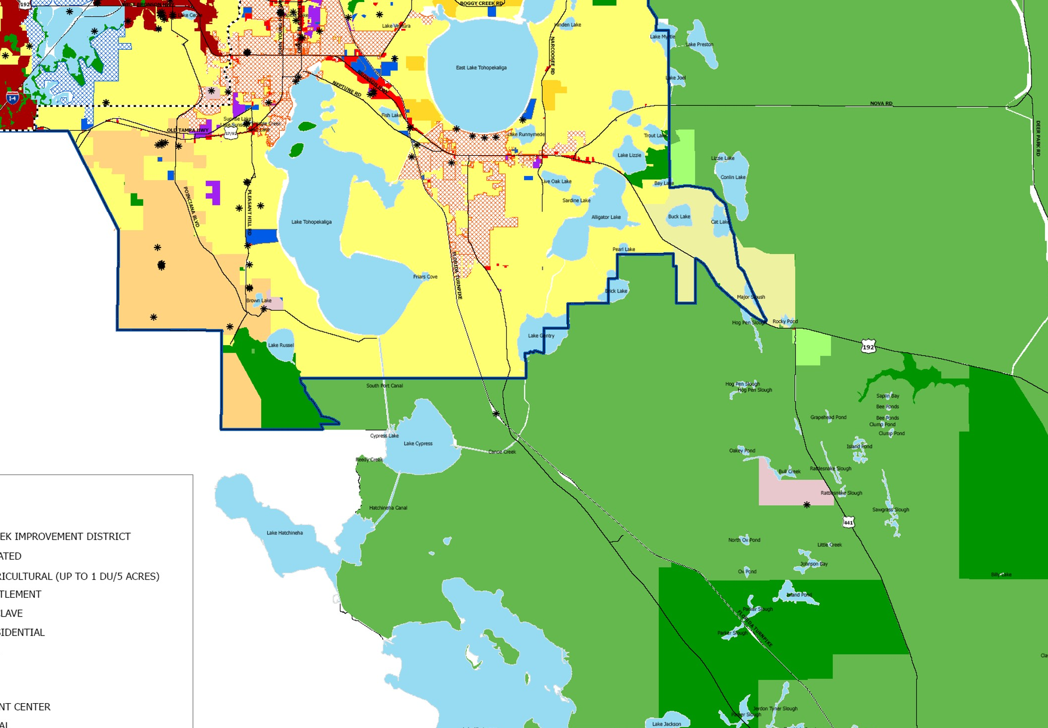
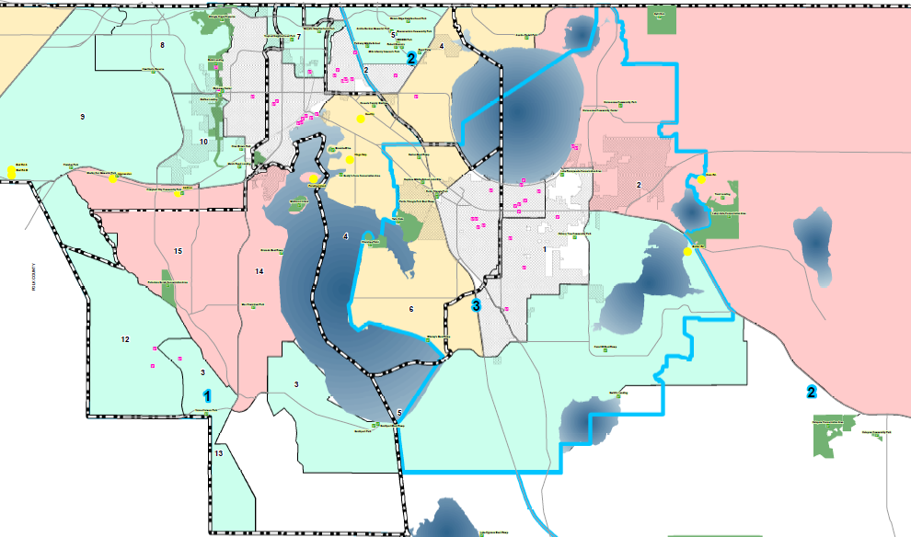
Comprehensive Plan
Required of all local governments
  Sets long range vision for County
  Addresses future land use, transportation, infrastructure, housing, natural resources, etc.
  Local governments are required to accommodate projected population growth (as projected by the state)
  County has set Urban Growth Boundary (UGB) – separates County into urban and rural (2/3 of County is rural, growth directed to UGB)
  All development must be consistent with Comprehensive Plan

Slide 8
2005 Evaluation and Appraisal Report (EAR)
Presented a FLUE with suburban character
Received Objection, Comments, and Recommendations (ORC) Report from the Department of Community Affairs (DCA)
  Plan encouraged Urban Sprawl
  Lack of Fiscal Ability to support expanse of growth
  Could not support minimal densities and maintain UGB as presented
Changes Required by the State of Florida
Increase densities for support UGB
Maintain minimum densities and intensities
Mixed-use development/land use
Introduce and support Multimodal transportation

Slide 9
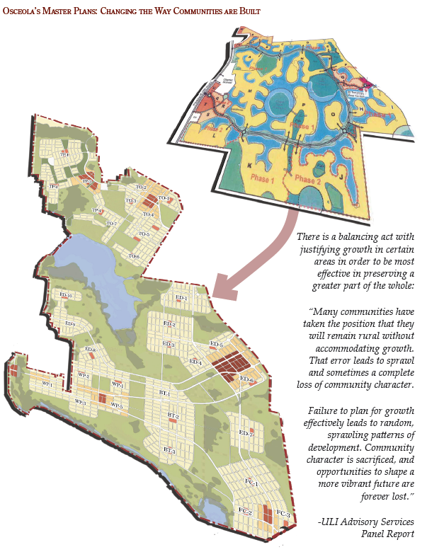
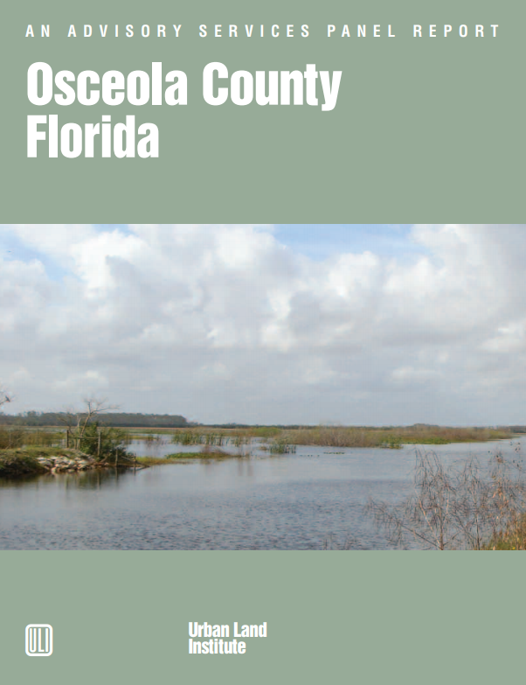
2006-2007
ULI Advisory Panel assisted the County
Remaining rural without accommodating growth was not an option
Failure to plan for growth leads to sprawling disconnected development
Conscious choice and planning is the best way to maximize the benefits of growth
County does not dictate whether there will be growth, but rather how the area will grow

Slide 10
2006-2007
Lake Toho DRIs
32,000 housing units
3.7 million square feet retail
840,000 square feet industrial
Urban Land Institute (ULI) Recommendations
To accommodate DRI and growth projections
Recommended a vision for growth
Mixed-use communities
Multimodal transportation opportunities

Slide 11
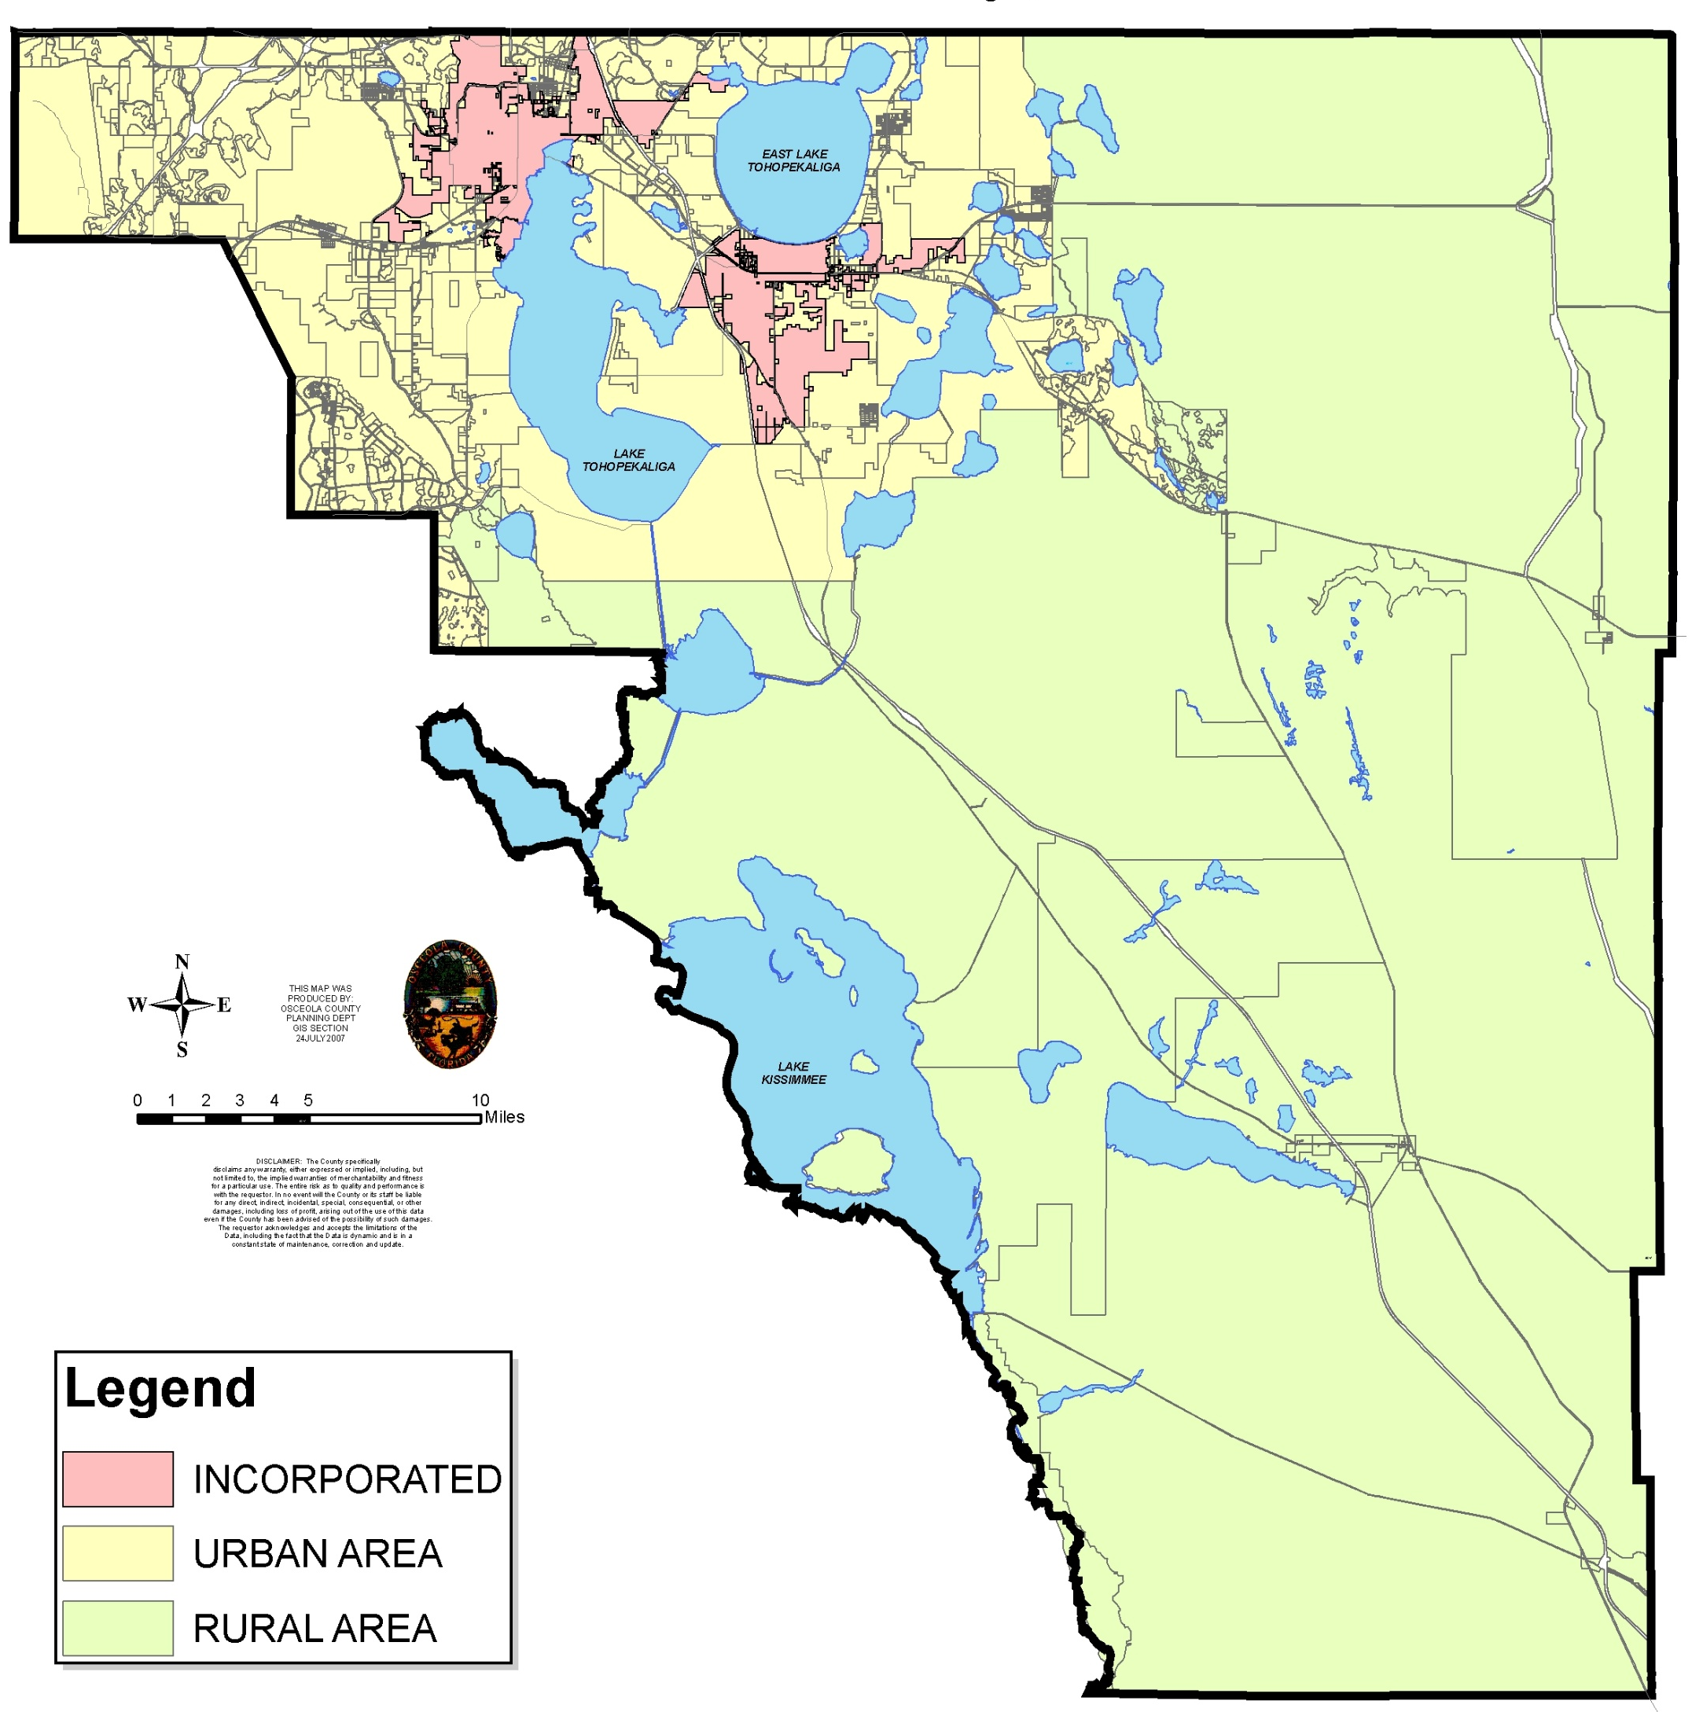
2006-2007
Comprehensive
Plan Update
Urban Growth Boundary
  Clear separation of urban and rural
  Directs growth to urban area
Mixed Use Districts (MXDs)
  Embody Plan’s growth principles
  Higher densities, intensities
  Mixed uses
  Highly connected road network
  Multimodal transportation
  Balance of jobs and housing

Slide 12
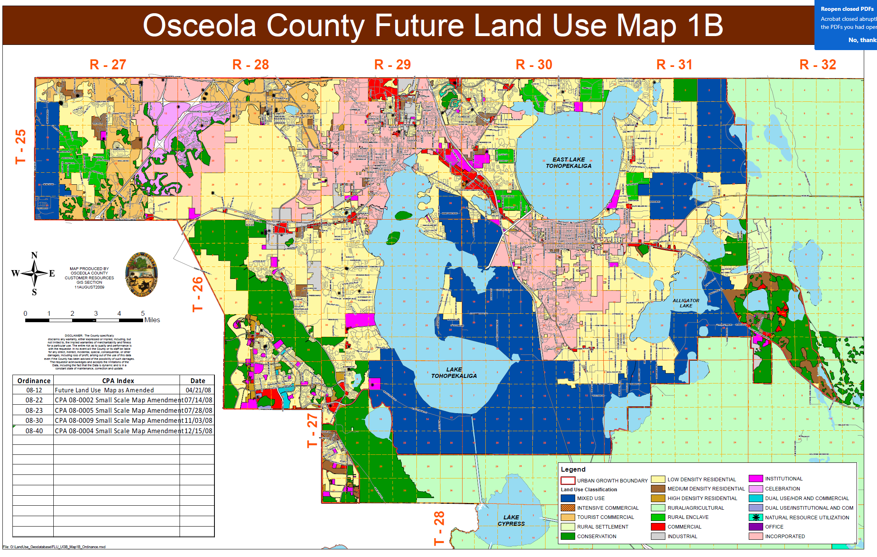
2007-2008
Settlement Agreements
Adopted the EAR based amendments with changes based on ORC Report
Enhanced Environmental Protections
Minimum Densities and Intensities
Mixed Use Land Uses
  Updated Transportation networks

Slide 13
2010-2012
Restructured Land Development Code
  Changed framework of code for ease of use
  From 22 chapters to 5
  Added siting standards
  Architectural standards
  Special areas
  Narcoossee Overlay
  Mixed Use Districts

Slide 14
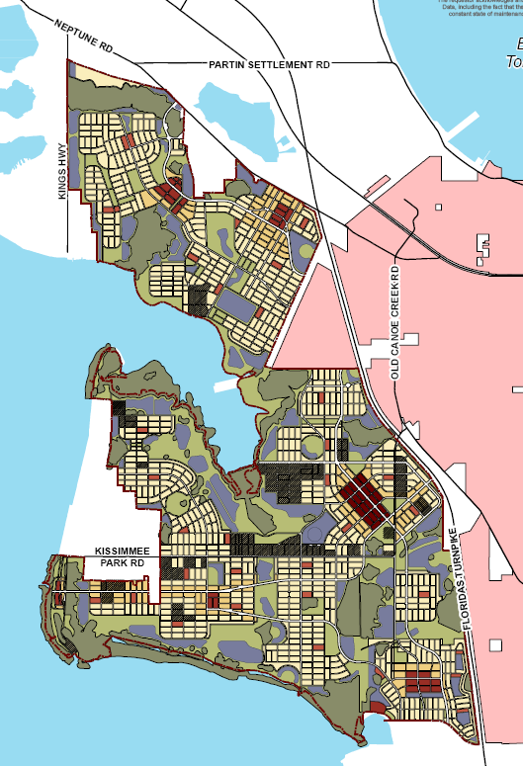
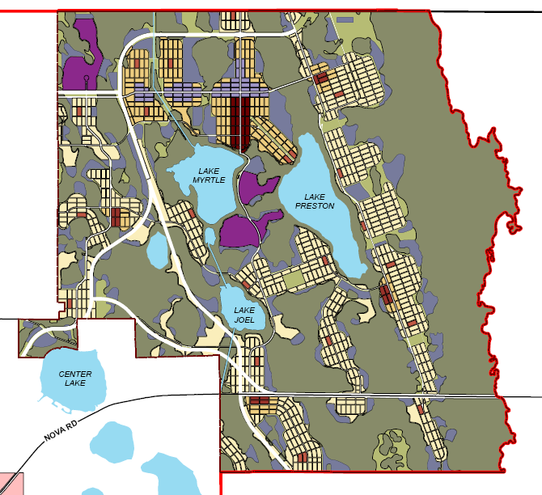
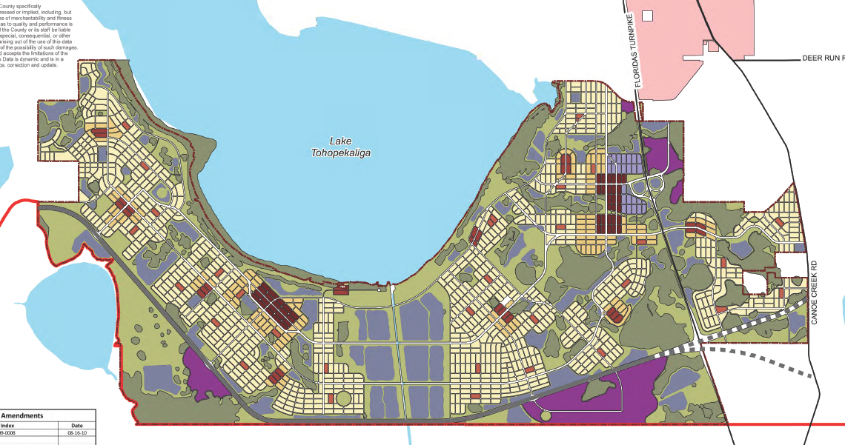
2010-2012
Restructured Land Development Code
Mixed Use Districts (MXDs)
  Conceptual Master Plans adopted
    East of Lake Toho
    South Lake Toho
    Northeast District
  MXD Land Development Code
    Addressed
      Place types and land uses
      Density and intensity
      Road connectivity
      Urban form
Notes:
County rezoned 50,000 acres in these three areas to mixed use in 2017

Slide 15
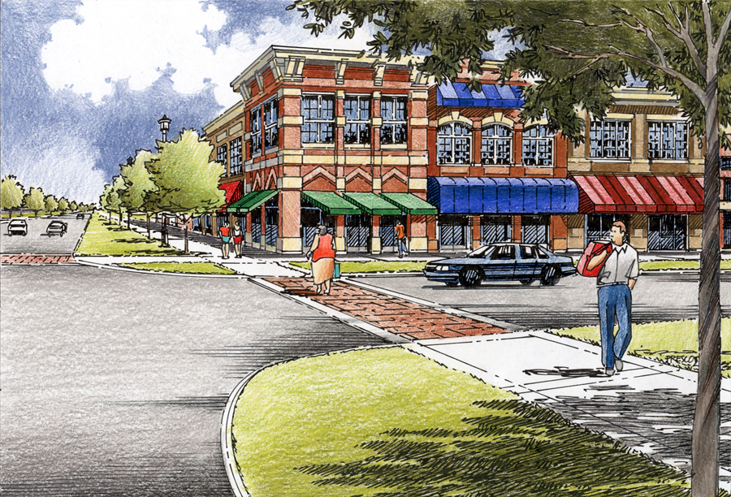
Active ground-floor uses
Large display windows
Public entrances
Building fronts on the street
Architectural Design
Details reflect local character/history
Variation in massing, façade, bays
Encouraged minimum 2-3 story
On-street parking
(Makes street more pedestrian friendly)
Build-to line
(0’-5’ from ROW)
Pedestrian amenities
Crosswalks
Wide sidewalks
Street trees
Awnings
Parking behind building
(With maximum standards to limit size and account for shared use)
MXD Land Development Code
Notes:
County rezoned 50,000 acres in these three areas to mixed use in 2017

Slide 16
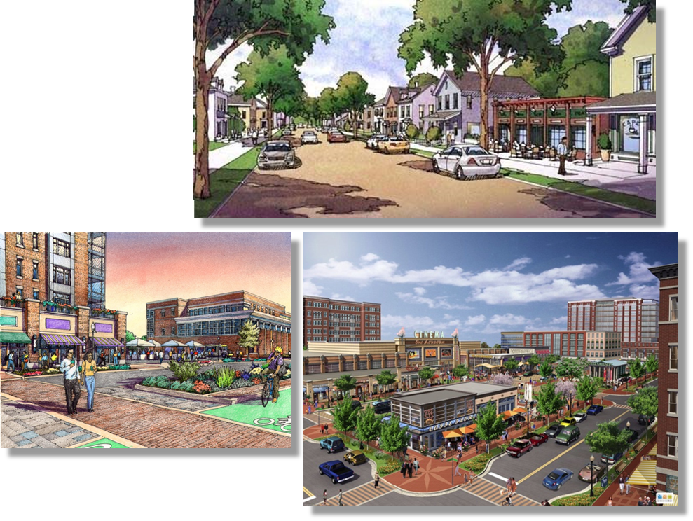
2019
Centers LDC Update
Established centers in LDC
          Neighborhood
    Community
    Urban
    Employment
Established development standards
Mix of uses
Development form
Architectural
Notes:
Changed the FLU to meet today’s market, make retail more viable
We need to market the Centers
Woodbury/Colonial Publix, Mills Park, Lucky’s at Pineloch – grocery and multifamily in same property

Slide 17
Results
Reserved areas to ensure balanced growth
Beginning to restore road network connectivity
Development occurring in MXD areas, Centers
Variety of housing product types
Development at Tupperware SunRail station – higher density/intensity, connectivity at station
Processes developed to work with school district and fire departments – integrating school and fire department planning with development
Notes:
Shift in understanding of developers – starting to see value in mix – understanding how neighborhoods work with variety

Slide 18
Results and Accomplishments
Additional LDC changes
  Higher level of connectivity
  Increased housing diversity
  Urban standards for parking, recreation
  Corridor area standards
  Integrate existing uses to be eliminated with evolution of development
Completing Conceptual Master Plan for MXD 5 and 6
Facilitating development in MXDs, Centers
Notes:
Shift in understanding of developers – starting to see value in mix – understanding how neighborhoods work with variety

Slide 19
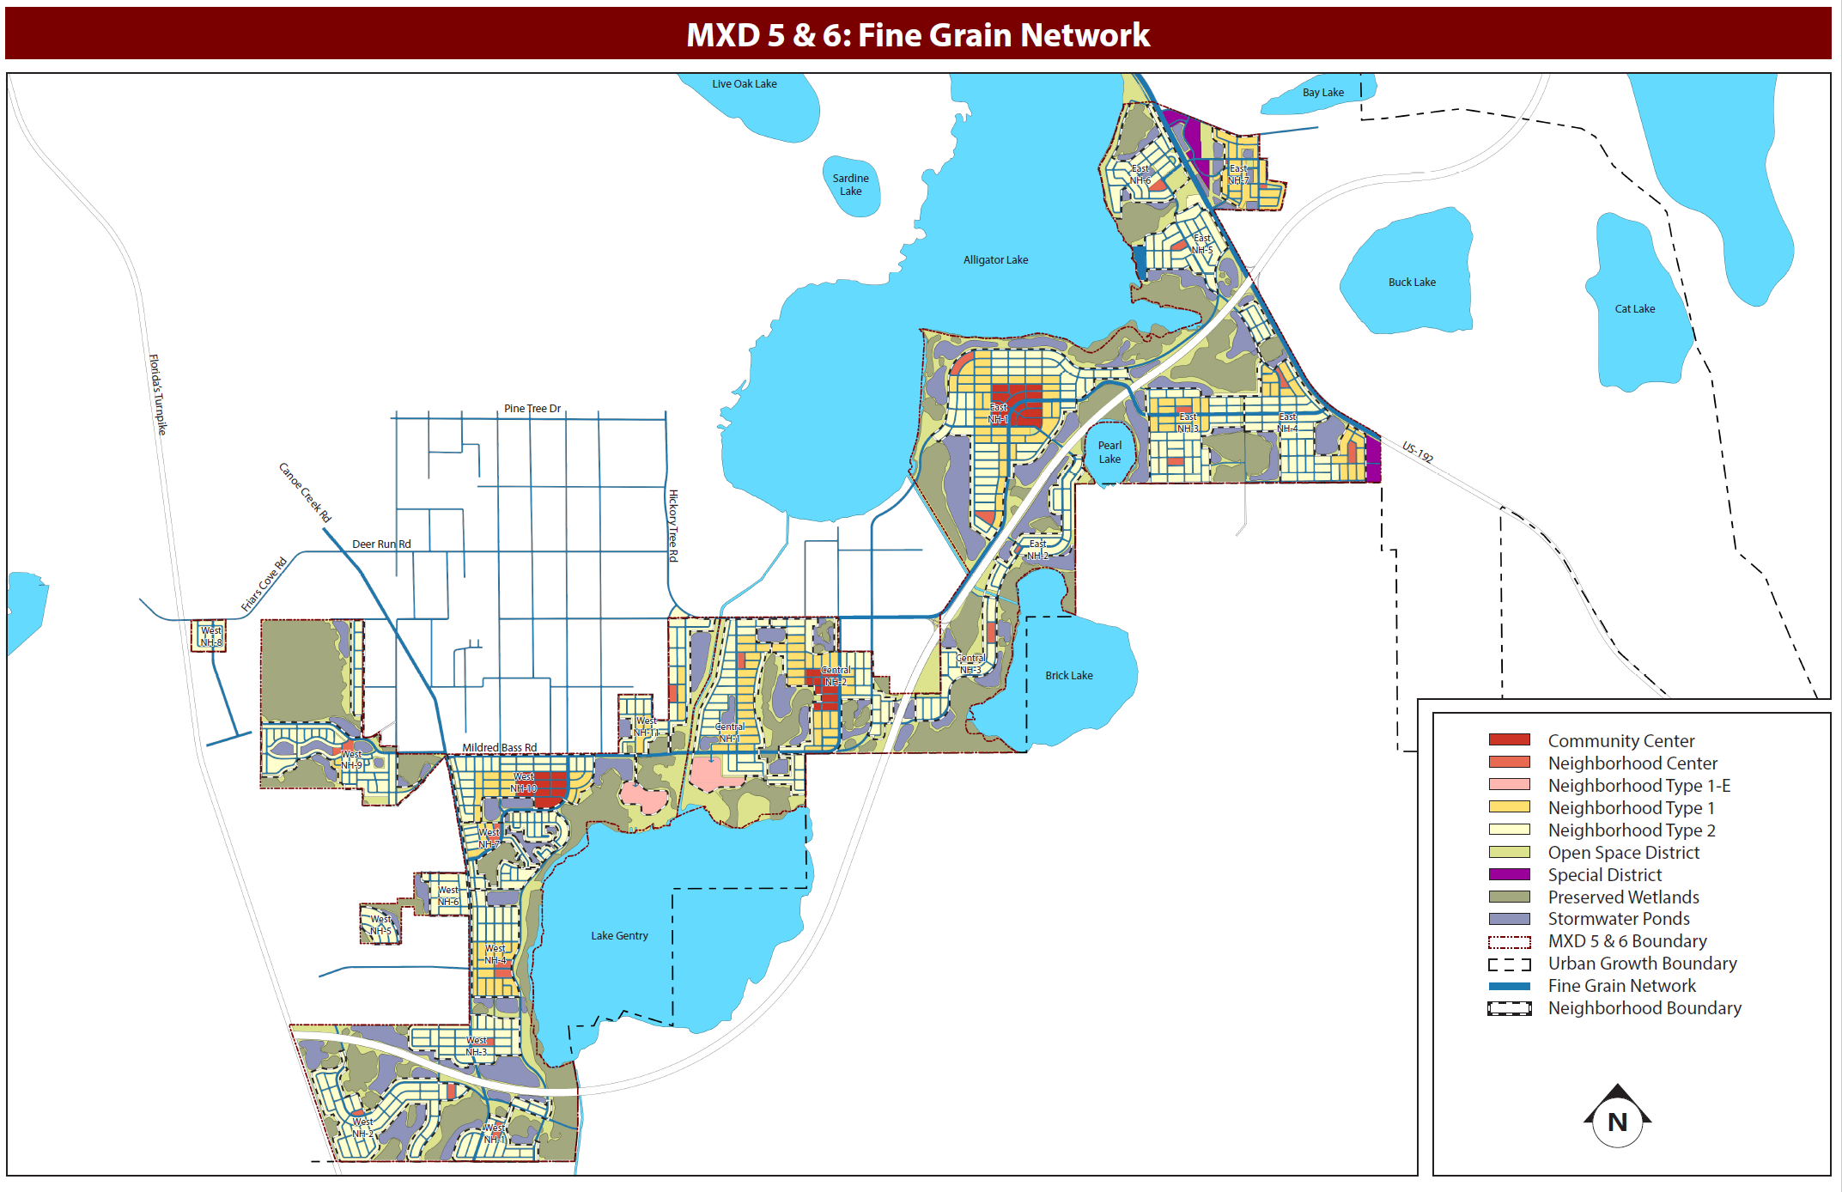
2022
Alligator Chain Of Lakes (ACL) Conceptual Master Plan (CMP) Adopted

Slide 20
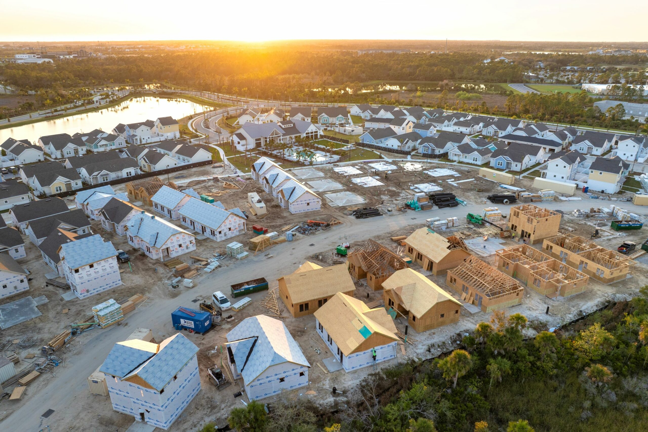
2023
Transitions to New Development
Transition to higher density and intensity
    Height transitions, 0-100 feet, >100 – 150 feet, > 150 feet
Sight line requirements
Standards to allow US zoning for subdivision less than 15 acres
In addition to existing setback and buffer requirements

Slide 21
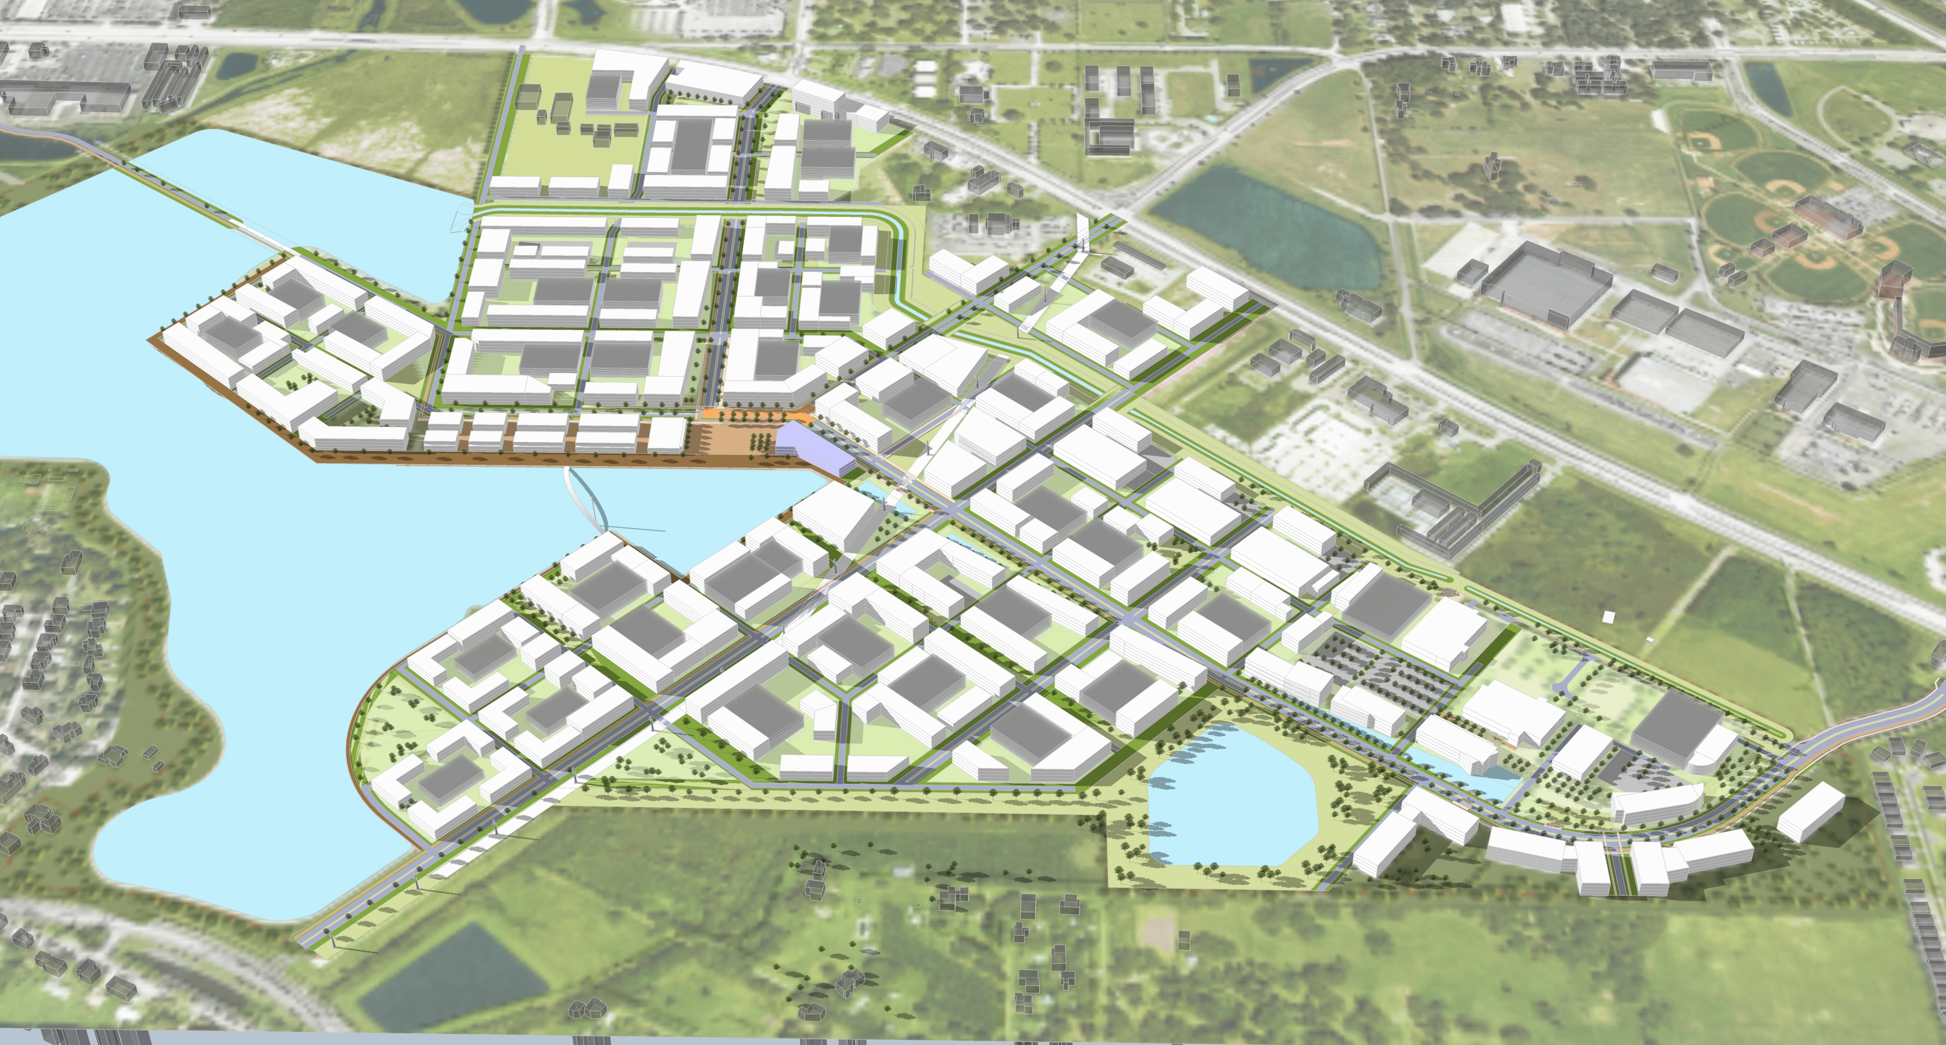
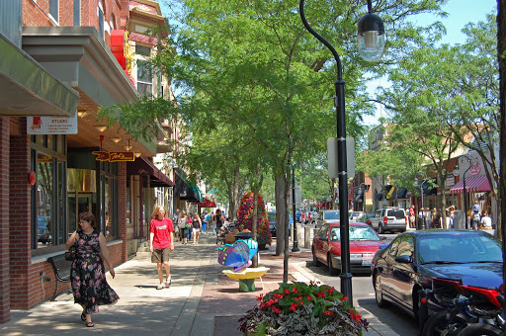
Accomplishments
Now that growth strategy is in place
Reserved areas for balanced growth
Beginning to restore road network connectivity
Development occurring in MXD areas, centers
Variety of housing product types
Development at Tupperware SunRail station – higher density/intensity, connectivity at station
Next steps
Incentivize center development
Adjust for changing retail market
Balance residential/nonresidential
Notes:
But we have a plan to move forward with growth, we just have to put that plan in place and let it work.

Slide 22
Legislative Mandates and Updates
2023 – SB102 Live Local Act (enacted)
The law empowers developers to bypass local zoning, density, and height
restrictions
Zoning Pre-emption:
Local governments must allow multi-family or mixed-use residential developments in areas zoned for commercial, industrial, or mixed-use if at least 40% of the units are for affordable housing.
Density & Height: Projects must be approved if they meet density and height requirements (highest allowed in the county), usually allowing at least 150% of the current floor area ratio.
Impacts and Revisions:
The law reduces the review time for project approvals, often bypassing local government site plan reviews.
Developer Interest: The incentives for developers include increased density and tax savings
Local Control Controversy: The act limits the ability of local governments to manage zoning, which has led to some disputes.

Slide 23
Legislative Mandates and Updates Cont.
2025 – SB180 (enacted)
Comprehensive act related to emergencies, includes restrictions on county or
municipal regulations after certain natural emergencies.
Each county listed in the Federal Disaster Declaration for Hurricane Debby (DR-4806), Hurricane Helene (DR1323 4828), or Hurricane Milton (DR-4834), and each municipality within one of those counties, may not propose or adopt:
Any moratorium on construction, reconstruction, or redevelopment of any property damaged by such hurricanes;
More restrictive or burdensome amendments to its comprehensive plan or land development regulations; or
More restrictive or burdensome procedures concerning review, approval, or issuance of a site plan, development permit, or development order.
This provision applies retroactively from August 1, 2024, through October 1, 2027.

Slide 24
Legislative Mandates and Updates Cont.
2025 – SB1080 (enacted)
New mandatory timeline for application review.
Counties and municipalities are now bound to act within specific periods, or else face
financial consequences.
Acknowledgement of receipt within five business days.
Determination of completeness within 30 days.
Final decision. If application doesn’t require final action through a quasi-judicial or public hearing, the government must approve, approve with conditions, or deny the application within 120 days after the county or municipality has deemed the application complete. If the matter requires a quasi-judicial or public hearing, that deadline is extended to 180 days.
Refunds for delay. Failure to meet these deadlines triggers a statutory obligation to refund portions of the applicant’s fees.
When a development permit or development order is denied, the local government must provide the applicant with written notice that cites the specific ordinance, rule, statute, or other legal authority supporting the denial.

Slide 25
Legislative Mandates and Updates Cont.
2025 – SB1730 YIGBY/Modifications to LLA (enacted)
Counties and municipalities are now bound to act within specific periods, or else face
financial consequences.
Requires local governments to grant administrative approvals for qualifying projects without further action by any quasi-judicial or administrative board or reviewing body.
Clarifies zoning preemption applicability by defining “commercial,” “industrial,” and “mixed-use zoning,” and confirms applicability to flexibly zoned areas like planned unit developments.
Reinforces that density, FAR, and height maximums are set to the least restrictive or highest standard currently allowed or allowed as of July 1, 2023.
Allows local government approval for affordable housing on religious-owned parcels that include a house of public worship regardless of underlying zoning.

Slide 26
Legislative Mandates and Updates Cont.
2026 – Property Tax Exemption (Not currently approved for Ballot)
In February 2026, the Florida House of Representatives passed a joint
resolution that would have dramatically altered how property taxes are applied to
homesteaded properties. (Senate did not approve a matching version)
The proposal focused on eliminating the non-school portion of property taxes on primary residences including taxes assessed by counties, cities, and special districts.
Because this proposal would change the Florida Constitution, it was not a law. Instead, it was structured as a constitutional amendment that would ultimately require voter approval in a statewide election. If adopted, the proposal was expected to take effect beginning in 2027.
Concerns:
How local governments would replace the lost revenue, particularly for essential services such as law enforcement, fire protection, and infrastructure.
No clear consensus if alternative funding sources, such as increased sales tax or tourism-based revenue, could reliably fill the gap.
    No constitutional amendment has been finalized for the ballot
    No immediate or scheduled elimination of property taxes is in effect

Slide 27
What is the Transportation Element of the Comprehensive Plan?
  Set of policies and projects designed to create a safe, efficient, and sustainable transportation system. The plan aims to reduce reliance on cars and encourage a mix of transportation options.
  Goals
      Coordinated internally and with local, regional, and state agencies
      Multimodal System
      Managed and monitored using mobility standards and best practices for roadways, transit, bike/ped/trail systems
      Prioritize and establish sustainable funding mechanisms
  Includes a series of transportation maps showing the County’s road network, transit corridors, bicycle and trail facilities, and air transportation facilities for 2040 and 2080.
Notes:
CNC
Osceola County's Transportation Element of the Comprehensive Plan is a set of policies and projects that aim to create a safe, efficient, and sustainable transportation system. The plan also aims to reduce reliance on cars and encourage a mix of transportation options.
Goals
Coordinated internally (with the Comp/Land Use Plan) and with local, regional, and state agencies
Multimodal System supporting livable communities and economic development, where access and travel choices are increased through new and enhanced public transit, bicycle, pedestrian, and roadway systems.
Managed and monitored using mobility standards and best practices for roadways, transit, bike/ped/trail systems
Prioritize and establish sustainable funding mechanisms
Includes a series of transportation maps showing the County’s road network, transit corridors, bicycle and trail facilities, and air transportation facilities for long range planning (current horizons are 2040 and 2080). Eventually update to 2045 and 2085.

Slide 28
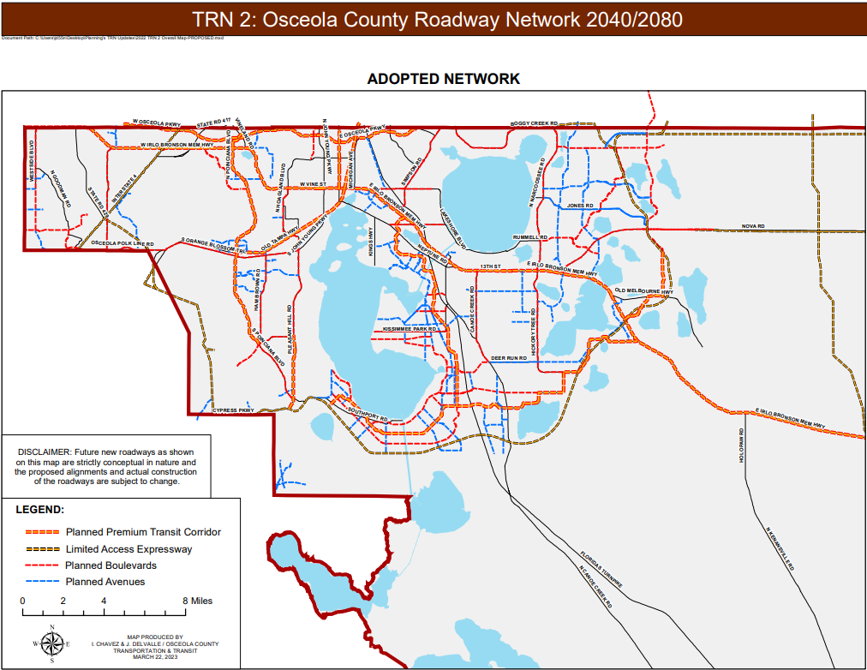
Comprehensive Plan
Transportation Maps
TRN 2: Osceola County Roadway Network 2040/2080
  County Roadways = “Framework” roadway network with defined standards
    Planned Premium Transit Corridor
    Planned Boulevards
    Planned Avenues
  Local Roads
    Not part of County Framework roadway network
    Funded by developers and constructed to standards contained in the Land Development Code
    Coordinated connections with the County’s Framework road network
Notes:
For Osceola County we want to:
Align land use with transportation planning to ensure sustainable growth.
Address localized needs while contributing to regional objectives.
County Roadways = “Framework” roadway network with defined standards
Planned Premium Transit Corridor
Planned Boulevards
Planned Avenues
Local Roads
Not part of County Framework roadway network
Funded by developers and constructed to standards contained in the land Development Code
Coordinated connections with the County’s Framework road network

Slide 29
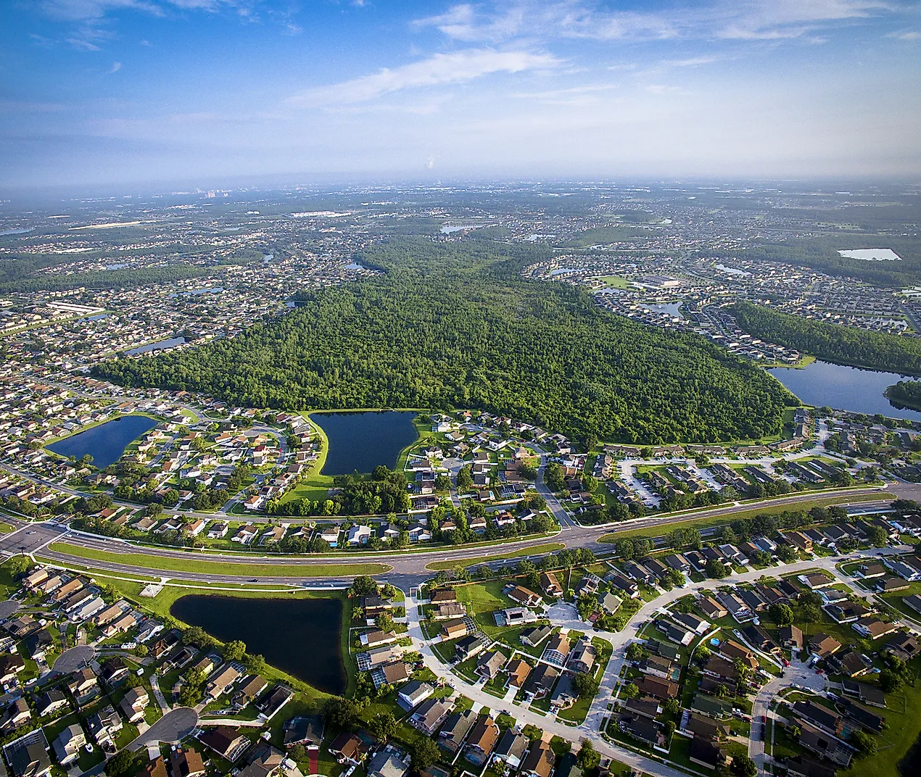
Long-Range Transportation Planning
  Objective: Proactive vs. reactive to address growth demands and enhance connectivity.
  Collaboration: Align projects with Central Florida Expressway Authority (CFX), Florida Department of Transportation (FDOT), and Florida’s Turnpike Enterprise (FTE).
  Key Outcomes: Support economic growth, reduce congestion, and improve multimodal transportation.
Notes:
With 2040 and 2080 as our horizons, we’re taking a long view.
Objective: Proactive vs. reactive considering the planned regional transportation system to address growth demands and enhance connectivity.
Collaboration: Align projects with Central Florida Expressway Authority (CFX), Florida Department of Transportation (FDOT), and Florida’s Turnpike Enterprise (FTE).
Key Outcomes: Support economic growth, reduce congestion, and improve multimodal transportation.

Slide 30
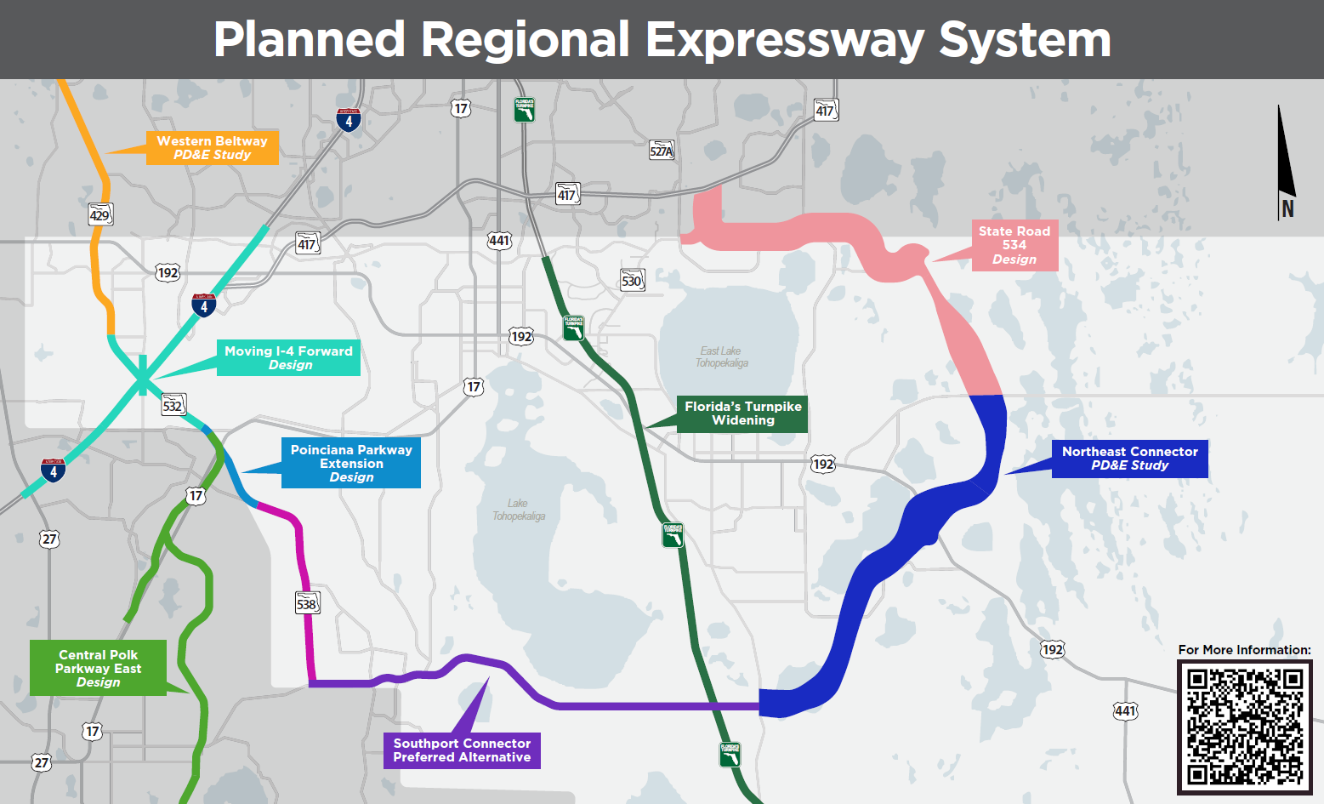
Notes:
Speaking of that long term view and coordination with our transportation partners, we have this planned regional expressway system.
Key Projects in the Regional Expressway System:
Western Beltway Widening (Florida’s Turnpike Enterprise):
Scope: Expand capacity on State Road (SR) 429 to address increased traffic volumes.
Progress: Project Development & Environment (PD&E) study complete.
Resource: Western Beltway Widening PD&E
Part of Moving I-4 Forward….Poinciana Parkway Extension Connector (Florida’s Turnpike Enterprise):
Scope: Direct connection from Poinciana Parkway to I-4.
Objective: Seamlessly link residential and employment centers.
Resource: Poinciana Parkway Connector PD&E
Poinciana Parkway Extension (CFX):
Scope: Extend SR 538 to County Road 532 to improve access to growing neighborhoods.
Resource: Poinciana Parkway Extension Project
Widening of Poinciana Parkway (CFX):
Scope: Increase capacity between Ronald Reagan Parkway and Cypress Parkway.
Objective: Alleviate congestion, improve travel times.
Resource: SR 538 Capacity Improvements
Southport Connector (CFX):
Scope: Connect existing infrastructure to Poinciana and surrounding areas.
Impact: Expands access for residential and commercial developments.
Resource: Move Poinciana
Northeast Connector Expressway (CFX):
Scope: Extend SR 515 to provide regional connectivity.
Stage: Phase 2 PD&E study underway.
Resource: Northeast Connector PD&E Study
Osceola Parkway Extension (CFX):
Scope: Extend Osceola Parkway to enhance regional east-west connectivity.
Challenges: Balancing growth and environmental preservation.
Resource: Osceola Parkway Extension
Turnpike Widening Initiative (FTE):
Scope: Increase capacity through Osceola County to meet existing and future travel demands
Resource: Featured Projects

Slide 31


Why Mobility Fees Matter
Impact of Rapid Growth on Transportation
Benefits of Mobility Fees
  Sustainable funding for critical projects
  Equitable distribution of costs among developers
  Alignment with the county’s growth-management goals
Notes:
CNC
Increased congestion and insufficient funding threaten the County’s infrastructure.
Mobility fees ensure new developments contribute fairly to transportation improvements needed to accommodate those new developments.

Slide 32
PROJECT DELIVERY PROCESS
Concept Study
PD&E Study
Design
Construction
Master Plan Identifies Regional Needs
Master Plan Identifies Regional Needs
Updated March 2024
Notes:
Before a road can be built or improved, there is generally an established process:
The Master Plan identifies the regional needs and outlines the transportation goals for the county.
The Concept Study. In this stage, various concepts and alternatives are considered to address the identified needs.
The PD&E Study, Project Development and Environment Study, evaluates the potential impacts and benefits of the proposed project, considering environmental, social, and economic factors. This can take up to 2 years to complete.
The Design, where detailed plans, right-of-way needs, and specifications are developed. Design is generally a two-year process, as well.
And finally, the construction stage, which involves the actual construction of the road project based on the approved design. Depending upon the complexity of the road-building, construction can take anywhere from two to four years.
The projects we’re discussing today are ready in construction!

Slide 33
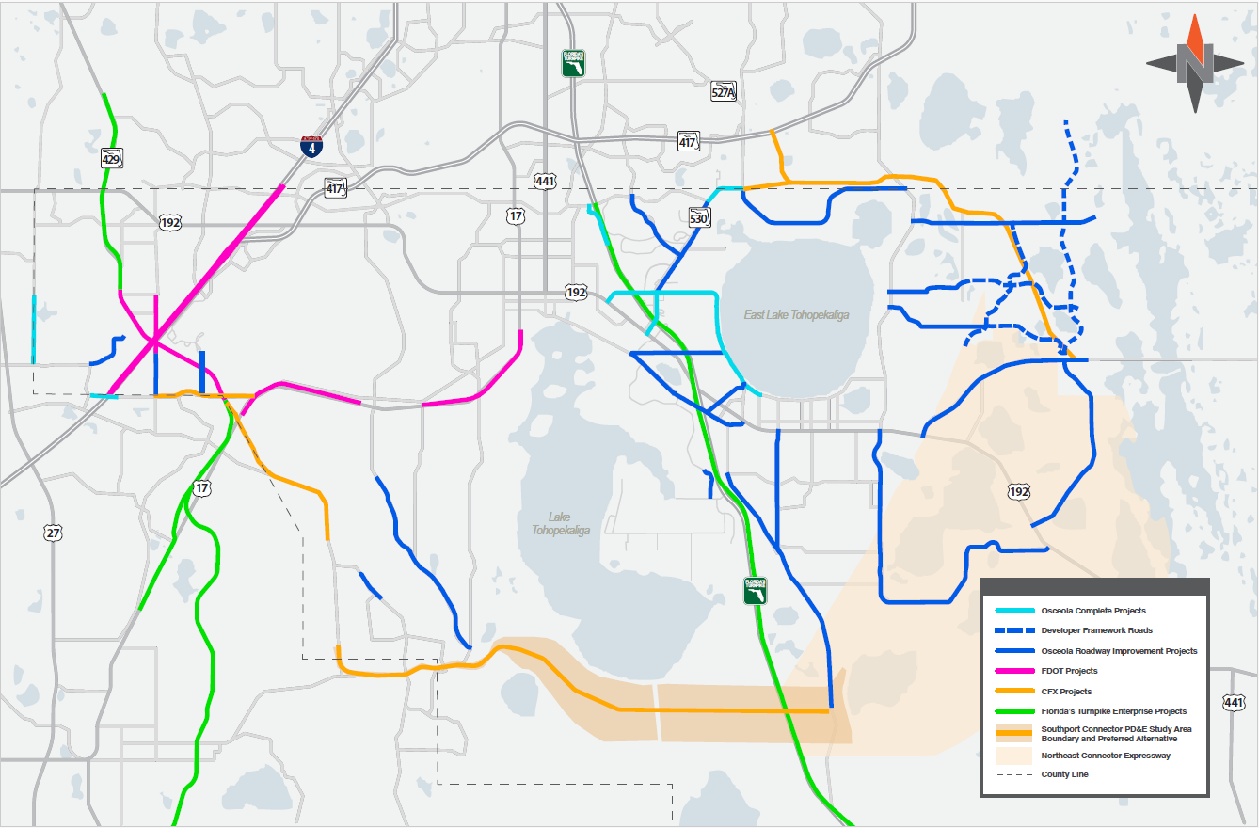
OSCEOLA COUNTY ROAD WIDENING PROGRAM
Notes:
The Osceola County Board of County Commissioners is fully committed to improving transportation options for all residents of our county. In late 2019, the Commissioners made a significant and historic investment in road improvements by refinancing bonds that were originally used to construct Osceola Parkway.
Approximately $200 million from the refinanced bonds has been allocated for the design and construction of five important roadways (Simpson Road, Boggy Creek Road, Poinciana Boulevard, Bill Beck Boulevard, and Partin Settlement Road). To ensure successful outcomes, Osceola also actively collaborates with local, state, and federal transportation partners such as the Central Florida Expressway Authority, the Florida Turnpike Enterprise, the Florida Department of Transportation, and the Federal Highway Administration. This slide shows all of the road projects that the County and its transportation partners are currently advancing into construction.
Next, I’d like to give you some details about five specific County-funded road improvement projects that are ready for construction. They are already under construction.

Slide 34

PROJECTS IN CONSTRUCTION
Boggy Creek Road Widening
  From Simpson Road to Narcoossee Road
Buenaventura Boulevard Improvements and Complete Streets
  From Florida parkway to Osceola Parkway
Cyrils Drive Widening
  From Narcoossee Road to Absher Road
Jack Brack Road Extension
  From Absher Road to the south entrace of the Del Webb community
Marigold Avenue Roundabouts
  San Lorenzo Road, Laurel Avenue, and Peabody Road Intersections
Neptune Road Widening
  From Partin Settlement Road to U.S. 192
Partin Settlement Road Widening
  From Neptune Road to E. Lakeshore Boulevard
Poinciana Boulevard Widening
  From Trafalgar Boulevard to Pleasant Hill Road
Simpson Road Widening
  From Winners Circle to Osceola Parkway
Scan QR code for more information:
Notes:
Completed:
Westside Boulevard Extension: From Barry Road to south of Solara Resort
Fortune Road and Simpson Road Intersection
Simpson Road: From U.S. 192 to Winners Circle
Kissimmee - St. Cloud Connector Trail

Slide 35
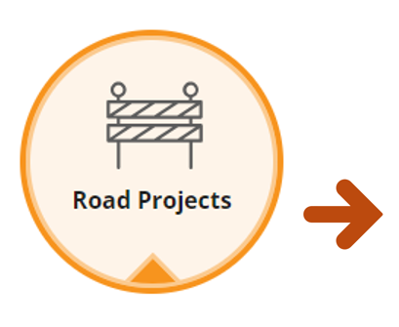
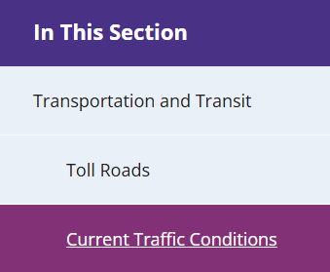

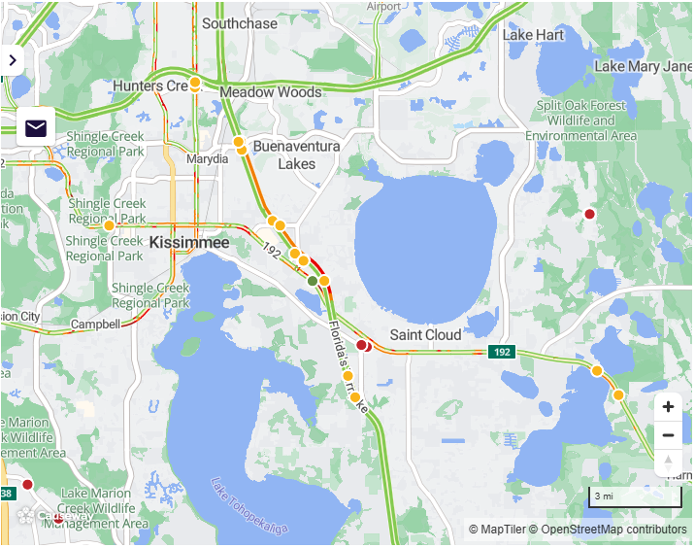

TMAS: Osceola County’s Traffic Management Advisory System
TMAS has the most essential and current information on traffic conditions, including road closures, construction, and traffic impacts. It is Integrated with major navigation apps like Waze, Google Maps, and Apple Maps, to help drivers plan safer, more efficient trips.
Find TMAS at Osceola.org → Current Traffic Conditions
Powered by Causeway, the TMAS platform is publicly accessible without an account.
Scan the QR code to access the interactive map and learn how to receive alerts about Osceola County real-time road closures and traffic updates.
Updated March 2024

Slide 36


ROAD SAFETY
Reduce speed when approaching construction areas.
Speeding fines can be doubled in construction zones.
Stay vigilant and pay attention to any sudden roadway shifts.
Anticipate and adapt to changes in the road layout.
Follow directional signs and markings.
  Obey vehicle and pedestrian detour instructions to avoid accidents or delays.
  Remain patient when encountering construction zones to ensure everyone's safety.
  Understand delays, potential noise and dust are temporary and necessary for ongoing improvements.
Updated March 2024
Notes:
While these improvements will greatly enhance safety for motorists, bicyclists and pedestrians alike – it’s equally important during construction that everyone pays extra attention to road safety awareness. Here are some key points to keep in mind:
- Slow down: Reduce your speed when approaching construction areas and adhere to reduced speed limits. Speeding fines can be doubled in construction zones.
- Pay attention: Stay vigilant for sudden roadway shifts or changes in the road layout within construction zones. Follow directional signs and markings to adapt to these changes.
- Follow detours: Obey detour instructions and stick to designated routes to avoid accidents and delays for yourself and others.
- Be patient: Construction zones may cause temporary delays. Understand the importance of these improvements and practice patience for the safety of workers and motorists.
Road safety is a shared responsibility

Slide 37

Driving into the Future with Confidence
Osceola County
Commitment to Regional Collaboration
Innovation in planning and funding to meet future challenges
Building confidence in the ability to manage growth sustainably
Partnerships as a cornerstone for successful growth management
Emphasis on shared responsibility among stakeholders
Notes:
CNC
As we come to the end of this journey today, I’d like you to think back to that vision of Osceola County in 2035—the seamless roads, the walkable communities, the thriving businesses. It’s not just a dream; it’s a future we’re actively building together. Every decision we make today, every tool we develop, and every partnership we form lays the groundwork for that future.
What we’ve discussed—comprehensive planning, mobility fees, and strategic partnerships—isn’t just about infrastructure. It’s about people. It’s about creating opportunities for families to spend more time together and less time stuck in traffic. It’s about empowering businesses to grow in a community designed for their success. And it’s about ensuring that our transportation systems don’t just catch up with growth—they guide it in the right direction.
Everyone in this room plays a critical role in this transformation. You bring the expertise, the innovation, and the commitment to ensure that growth doesn’t overwhelm us—it energizes us.
So, I leave you with this: Let’s commit to turning challenges into opportunities. Let’s work together to create systems that aren’t just responsive to growth but proactive in shaping it. And let’s build a future we can all be proud of—a future where mobility is about more than getting from point A to point B. It’s about connection, community, and confidence in the journey ahead.
Because the work we do now will be the foundation for the lives of millions tomorrow.

Slide 38



Links for Information
  Osceola County Comprehensive Plan, Land Development Code & GIS Maps
  www.osceola.org
  Future Land Use Information
  https://library.municode.com/fl/osceola_county/codes/comprehensive_plan
  Zoning Information
  https://library.municode.com/fl/osceola_county/codes/land_development_code
  Transportation and Transit Website
  https://www.osceola.org/Community/Transportation-and-Transit/Transportation-Improvement-Projects
Notes:
Here are a few helpful links for additional information we’ve covered today.

Slide 39
Thank you! Questions?
Cori Carpenter
Cori.Carpenter@osceola.org
P: 407.742.0296
Director Planning, Zoning, and Design
Jennifer A. Stults, AICP CTP, CPM
Jennifer.Stults@osceola.org
P: 407.742.7813
Director of Transportation Planning
Notes:
- Thank you for joining us today to learn about ongoing projects in Osceola County.
- We hope this presentation provided valuable information and insights.
- If you have any further questions or need additional information, please contact me.
- We appreciate your time and interest in our construction projects.
- Thank you and have a great day!

